Slide 1
Unit 4.2 Designing Forms and Reports
Introduction; Designing Forms and Reports (Process, Deliverables and Outcomes); Formatting Forms and Reports (General Formatting Guidelines, Highlighting Information, Color vs. No-Color, Displaying Text, Designing Tables and Lists, Paper vs. Electronic Reports); Assessing Usability (Usability Success Factors, Measures of Usability)

Slide 2
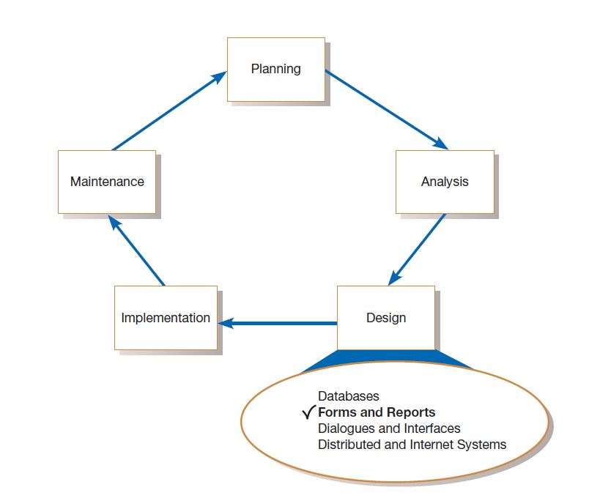

Slide 3
A form is a business document that contains some predefined data and often includes some areas where additional data are to be filled in. Most forms have a stylized format and are usually not in a simple row and column format. Examples of business forms are product order forms, employment applications, and class registration sheets.
A report is a business document that contains only predefined data; it is a passive document used solely for reading or viewing. Examples of reports include invoices, weekly sales summaries by region and salesperson, or a pie chart of population by age categories.

Slide 4
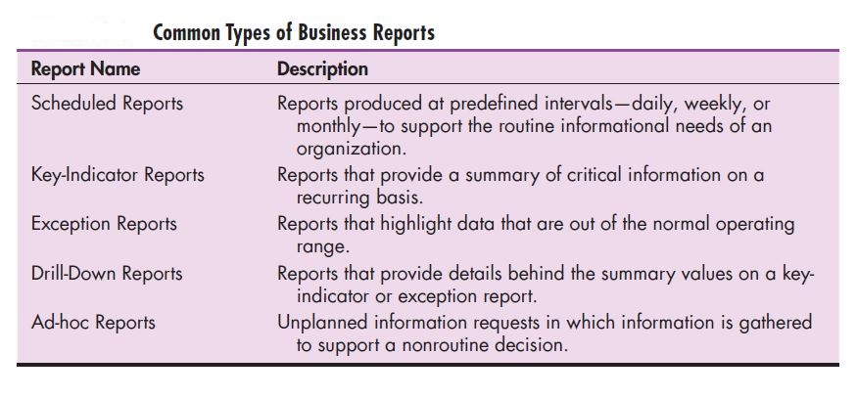

Slide 5
The process of designing forms and reports
Designing forms and reports is a user-centered activity that typically follows a prototyping approach. User-centered design refers to a design approach that involves an understanding of the target audience, their tasks and goals, information needs, experience levels, and so on. So, to begin, you must gain an understanding of the intended user and task objectives by collecting initial requirements during requirements determination.
During this process, several questions must be answered. These questions attempt to answer the “who, what, when, where, and how” related to the creation of all forms or reports. Gaining an understanding of these questions is a required first step in the creation of any form or report.

Slide 6
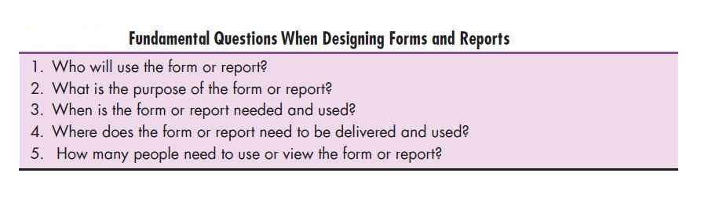

Slide 7
After collecting the initial requirements, you structure and refine this information into an initial prototype. Structuring and refining the requirements are completed independently of the users, although you may need to occasionally contact users in order to clarify some issue overlooked during analysis. Finally, you ask users to review and evaluate the prototype. After reviewing the prototype, users may accept the design or request that changes be made. If changes are needed, you will repeat the construction–evaluate–refinement cycle until the design is accepted. Usually, several iterations of this cycle occur during the design of a single form or report. As with any prototyping process, you should make sure that these iterations occur rapidly in order to gain the greatest benefits from this design approach.

Slide 8
Paper prototype
A series of mock screens that can be used to test content, look, and feel, as well as the task flow and other usability factors.
Wireframe
A simple design to show the placement of information elements on a screen and the space needed for each element.

Slide 9
Design specifications have three sections:
Narrative overview
Sample design
Testing and usability assessment

Slide 10
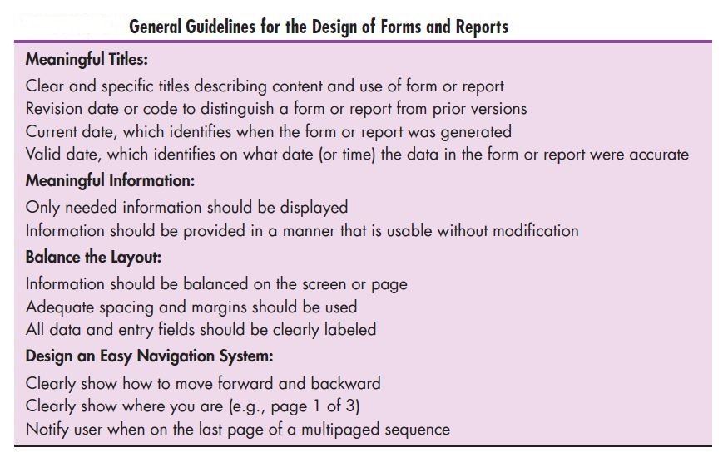

Slide 11
Highlighting Information
Blinking and audible tones
Color differences
Intensity differences
Size differences
Font differences
Reverse video
Boxing
Underlining
All capital letters
Offsetting the position of nonstandard information

Slide 12
There are several situations when highlighting can be a valuable technique for conveying special information:
Notifying users of errors in data entry or processing
Providing warnings to users regarding possible problems such as unusual data values or an unavailable device
Drawing attention to keywords, commands, high-priority messages, and data that have changed or gone outside normal operating ranges

Slide 13
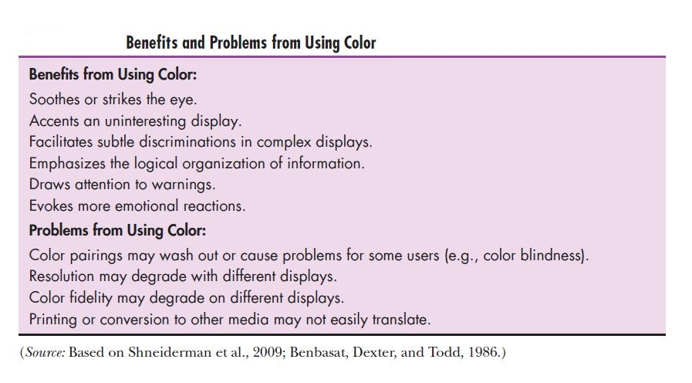
Color vs No color
Color is a powerful tool for the designer in influencing the usability of a system. When applied appropriately, color provides many potential benefits to forms and reports,

Slide 14
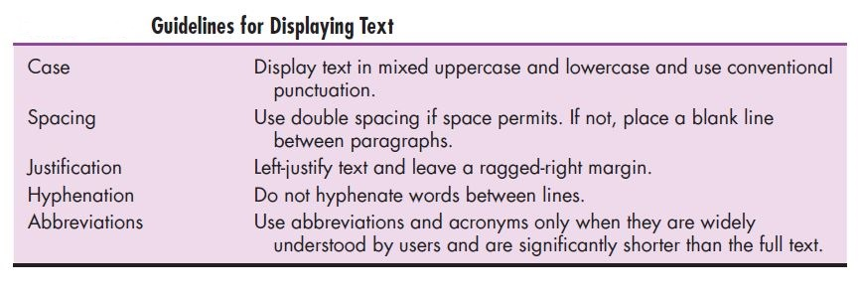

Slide 15
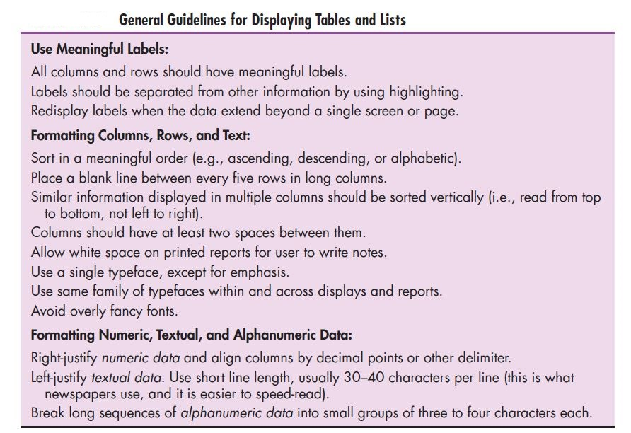

Slide 16
Guidelines for Selecting Tables versus Graphs
Use Tables For:
Reading individual data values
Use Graphs For:
Providing a quick summary of data
Detecting trends over time
Comparing points and patterns of different variables
Forecasting activities
Reporting vast amounts of information when relatively simple impressions are to be drawn

Slide 17
Usability
Usability means that your designs should assist, not hinder, user performance. Thus, usability refers to an overall evaluation of how a system performs in supporting a particular user for a particular task.
There are many factors to consider when you design forms and reports. The objective for designing forms, reports, and all human–computer interactions is usability.
Usability typically refers to the following three characteristics:
Speed - Can you complete a task efficiently?
Accuracy - Does the system provide what you expect?
Satisfaction - Do you like using the system?

Slide 18
Measures of Usability
User-friendliness is a term often used, and misused, to describe system usability. Although the term is widely used, it is too vague from a design standpoint to provide adequate information because it means different things to different people.
Consequently, most development groups use several methods for assessing usability, including the following considerations :
Learnability—How difficult is it for a user to perform a task for the first time?
Efficiency—How quickly can users perform tasks once they know how to perform them?

Slide 19
Measures of Usability
Error rate—How many errors might a user encounter, and how easy it is to recover from those errors?
Memorability—How easy is it to remember how to accomplish a task when revisiting the system after some period of time?
Satisfaction and aesthetics—How enjoyable is the system’s visual appeal and how
enjoyable is the system to use?

Slide 20
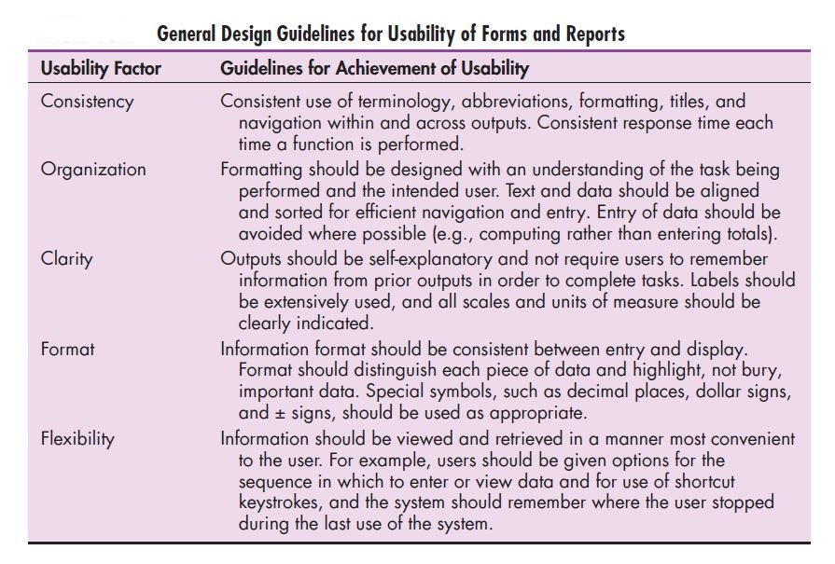

Slide 21
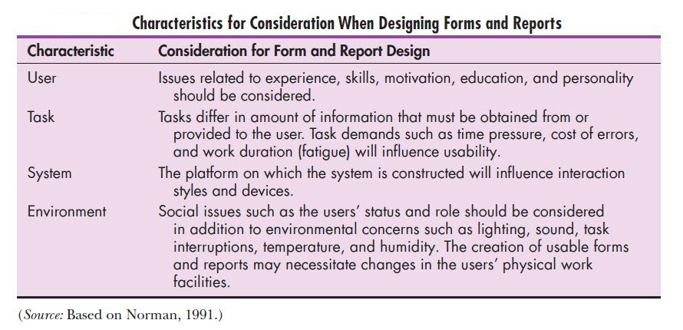

Slide 22
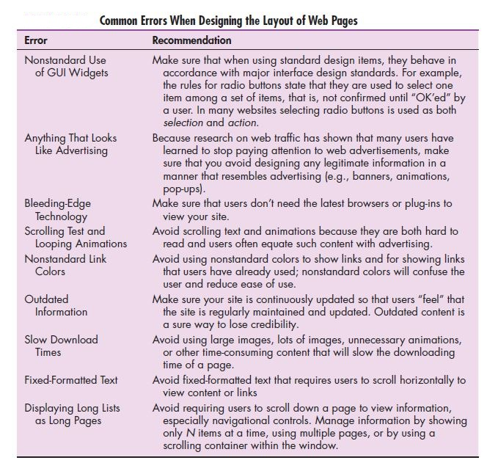

Slide 23
Lightweight graphics are small, simple images that allow a page to load as quickly as possible.
Stylesheet-based HTML
A web design approach that separates content from the way in which it is formatted and presented, making ongoing maintenance easier and site-wide consistency much higher.

